Slide 1
STAFF PRESENTATION

Slide 2
Why be nice.?
be nice. is a sustainable model
be nice. is mental health based
be nice. concentrates on resiliency
be nice. is visibly friendly
be nice. is an easy tool to use and understand

Slide 3
be one who knows the facts:
Mental health disorders affect 1 in 5 Americans. Serious emotional disturbance affects 1 in 10 young people.
79 percent of those children NEVER receive treatment and 45 percent of adults NEVER receive treatment (AJP, Sept 2002).
Suicide is the second leading cause of death amongst high school and college students and the tenth leading cause of death in adults.
Half of all mental disorders begin by age 14 and three quarters by age 24.
depression and other mental disorders, or a substance-abuse disorder (often in combination with other mental disorders). More than 90 percent of people who die by suicide have these risk factors.

Slide 4
be one who knows the facts:
Mental illnesses left untreated may lead to school failure, job loss, substance abuse and possible suicide.
Fewer than 10% of the public schools in America have a comprehensive mental health curriculum.
Early diagnoses and treatment results in accelerated recovery and the brain is protected from further damage related to the course of mental illness.
Healthier children, happier schools.

Slide 5
be one who knows what a mental illness is
A mental disorder or mental illness is a diagnosable illness that:
- Affects a person’s thinking, emotional state and behavior.
- Disrupts the person’s ability to:
- Work or attend school
- Carry out daily activities
- Engage in satisfying relationships

Slide 6
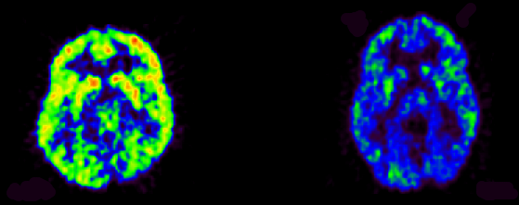
Brain Scan
scan of a healthy brain
scan of a depressed brain
The intensity of healthy brain activity can be measured by the colors. The most activity is the red, followed by yellow, green, and finally blue. The depressed brain is in a very low activity state almost like hibernation. You can see why mental concentration is not very good in someone who is depressed.

Slide 7




The nice. Action Plan
notice
invite
challenge
empower

Slide 8
The nice. Action Plan- notice
Visit benice.org
Click on be nice. icon on the top left
Scroll down to click on “Step 1 – notice”
notice video

Slide 9
notice
notice how people are treating each other. What do we do well? What needs to change?
What is right?
What is good?
What is different?
Notes:
What does it mean to our students to notice?
We need to be aware of ourselves, other people, our school, and our community.
We should all be noticed for our positive thoughts, feelings, and actions.
Encourage students to notice, teaching them to increase their awareness of themselves and others. They can do this by noticing what they, and the people around them, are doing and saying. They should notice what makes for a healthy school environment and what does not.
Why is it important to notice?
If we don’t notice something, we can’t begin to change it.
Sometimes it’s helpful to step back and observe the situation.
Look at it objectively and compare what you see with how you want things to be.
The difference between the two is the change you need to make.
What can we do to notice?
Start by looking for wards and actions that reflect the school environment that you want.
NOTICE what is RIGHT:
When you notice people saying or doing something positive, let them know that you appreciate it. When you notice that you have done something positive, congratulate yourself. When you are in class, notice what’s going well in your school by calling attention to it.
NOTICE what is GOOD:
Let no act of kindness go unrecognized.
Go out of your way to find something good about everyone you meet.
NOTICE what is DIFFERENT:
If you notice that someone’s mood or behavior has changed for no apparent reason, encourage students to tell an appropriate person like a school counselor or trusted adult.

Slide 10
notice: Risk Factors for Developing Depression
Previous episode of a mental illness or another mental illness
Family history/genetics
Learned behavior
Chemical imbalance
Substance misuse and sensitivity
Seasonal changes
Environmental factors
Exposure to stressful life events/abuse/trauma
Difficult of abusive childhood
Ongoing stress and anxiety
Medical conditions and hormonal changes
Side effects of medication
Illness that is life threatening, chronic, or associated with pain
Brain injury

Slide 11
notice: What can bring about a change in behavior?
  Top stressors:
  Heavy school workload
  Learning Disabilities
  Balancing academics, outside activities and social life
  Relationship drama
  Family conflicts, divorce, single parent households
  Siblings
  Language barriers
  Moving / changing schools / new classroom & teacher
  Ongoing/Constant Stressor (eg. “Bullying”)

Slide 12
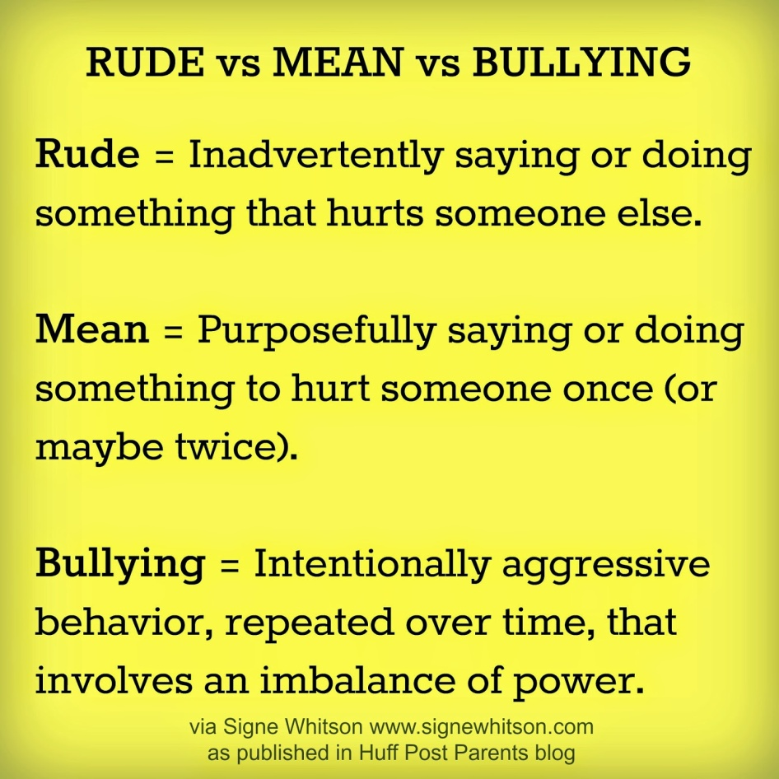
notice
What is “Bullying”?
RUDE
MEAN
BULLYING

Slide 13
notice – “bullying” relationship to mental health
Effects of “Bullying”
Children and youth who are bullied are more likely than other children to be depressed, lonely, anxious, have low self-esteem, feel unwell, and think about suicide (according to Limber, 2002; Olweus, 1993).
  It directly effects how they think, act and feel.
A victim of bullying is twice as likely to take his or her own life compared to someone who is not a victim (National Association of School Psychiatrists (NASP), 2011).

Slide 14
notice
Why is “bullying” on the rise?
People can be exposed to bullying 24/7
  facebook (or other social media sites)
  Twitter
  Instagram
  Snap chat
  Texting (screen shott)
  Raunchy comedies
  Violent video games (grooming)
  Reality shows make it entertainment
    American Idol

Slide 15
notice
Risk factors for suicide:
Depression and other mental disorders, or a substance-abuse disorder (often in combination with other mental disorders). More than 90 percent of people who die by suicide have these risk factors.
Stressful life events, in combination with other risk factors, such as depression. However, suicide and suicidal behavior are not normal responses to stress; many people have these risk factors, but are not suicidal.
Prior suicide attempt.
Family history of mental disorder or substance abuse.
Family history of suicide.
Family violence, including physical or sexual abuse.
Firearms in the home, the method used in more than half of suicides.

Slide 16
notice warning signs of suicide
People who have contemplated suicide report:
  Feelings of intense emotional distress involving:
    Depression
    Anger
    Anxiety
    Hopelessness
    Worthlessness
    Inability to change frustrating circumstances or to find a solution to their problems.
While stressors are rarely a sufficient cause of suicide they can be precipitating factors.

Slide 17
notice warning signs of suicide
Threatening to hurt or kill oneself
Seeking access to means
Talking or writing about death, dying, or suicide
Feeling hopeless
Feeling worthless or a lack of purpose
Acting recklessly or engaging in risky activities
Feeling trapped
Increasing alcohol or drug use
Withdrawing from family, friends, or society
Demonstrating rage and anger or seeking revenge
Appearing agitated
Having a dramatic change in mood
25

Slide 18
The nice. Action Plan - invite
Visit benice.org
Click on be nice. icon on the top left
Scroll down to click on “Step 2 - invite”
invite video

Slide 19
invite
be an inviting person.
invite yourself to make a change. Think of ways that you can make a difference in how others are treated at school.
inviting involves taking a risk and reaching out.
invite yourself to say something – to start a conversation.
Notes:
What does it mean to invite?
Inviting involves taking a risk and reaching out. Invite yourself to understand that how you treat someone has an effect on how they think, act, and feel. Teach students that inviting is an act of respect that can help to improve everyone’s mental health and the school environment.
Why is it important to invite?
If someone is invited they become less isolated.
When people are connected, they know that we’re all in this together.
People who are mutually supported are much more likley to be nice.
What can we do to invite?
Invite someone new
It’s impossibe to know ahead of time what a big difference a small action like this can make to someone else.
Invite yourself to say something
If you’ve noticed something is differet about someone, reach out to that person and to a trusted adult for help.
Be an inviting person
When you ask someone how they’re doing, really listen to their response.
Be consistent – reach out!
Remember: an invitation is powerful!

Slide 20
The nice. Action Plan- challenge
Visit benice.org
Click on be nice. icon on the top left
Scroll down to click on “Step 3 – challenge”
challenge video

Slide 21
challenge
challenge the individual to seek help – know resources
challenge yourself to ask questions
  How long have you been feeling this way?
  Have you talked to anyone about how you are feeling?
  Is there anyone or anything that has helped you in the past?
  Are you thinking about killing yourself?
challenge stigma
Notes:
What does it mean to challenge?
Once we’ve invited ourselves to make a change, it’s time to challenge ourselves to act. This isn’t always easy. Acting means taking a chance. There’s a chance that you’ll be ignored, criticized, or misunderstood. That’s why it’s a challenge.
Challenge means not being satisfied with the way things are and then doing something about it.
Why is it important to challenge?
If you let it go, you’re saying it’s ok.
Become part of the solution.
Talking about it isn’t doing it.
Taking the challenge to be nice. could change someone’s class period, their school day, their week --- even their life.
What can we do to challenge?
Challenge:
Yourself to reach out
It sometimes isn’t easy to leave our “comfort zones” and help someone who needs it. It’s a challenge.
Even the smallest bit of support can make a huge difference in a person’s life, often in ways that we don’t expect to see.
Challenge others to be inclusive and behave positively towards others
Challenging others to change their behavior can be intimidating, but it’s easier than you think; other people feel the same way that you do…most people want to be nice.
When someone isn’t taking the challenge to be nice, ask yourself if they might need someone to be nice. to them. To Notice, Invite, Challenge and Empower them.

Slide 22
challenge to seek help
Identify resources where they might find help when they are ready
  Hotlines
    Phone: 1-800-273-8255
    Text: 741741
  OK2Say – great program to utilize
  Providers – no insurance? Community Mental Health
  School Services
  Faith Leaders
  Peer/Parent Support Groups
  Organizations and Website – NAMI

Slide 23
The nice. Action Plan - empower
Visit benice.org
Click on be nice. icon on the top left
Scroll down to click on “Step 4 – empower”
empower video

Slide 24
empower
empower yourself with knowledge around your mental health and how you can effect others
empower yourself with your words – less stigmatizing
empower others with your support
empower your community with your leadership
empower others to make a change. Be a positive role model and encourage others to join in the movement.
Notes:
When you notice someone who needs help and you invite yourself to help them and you challenge yourself to be nice you are empowering yourself, your new friend, and those who were witnesses.
What can we do to empower?
To empower means to give power. Exercise the freedom to give power to yourself and others in your thoughts, feelings, and actions. Be encouraging to others, especially those who might doubt themselves. Lead by example.
Empower:
Yourself by taking the challenge
No matter what the outcome, it will feel empowering help someone with how they are thinking, acting and feeling.
The power that you feel when doing the right thing will be infectious.
be nice. to yourself; appreciate the peoson that you are and that you have the power to be nice.!
Others with your support
Once you have taken the challenge to reach out and be nice., you will be giving power through support to someone who needs it.
You might lift someone’s self-esteem so that they can in turn help someone else. It’s infectious.
Your community with your leadership
The ultimate goal be nice. initiative is to take it one step further and empower the community.
It takes everyone in a community to understand that be nice. is about improving the health of our community by taking care of how people think, act and feel.
Think of ways that you can empower your community with the be nice. message.

Slide 25
empower - Know protective factors
Access to services
Utilizing services
Being involved in activities and groups at school or outside of school
Having supportive family members and friends
Having and keeping strong morals
School connectivity
Positive Role Models
Faith
Positive attitude/optimism
Maintaining good boundaries
Coping skills
  What helps?

Slide 26
empower – Strong protective factors can lead to:
Self-esteem.
  Children who feel good about themselves refuse to tolerate bullying and defend themselves assertively and effectively (Egan and Perry, 1998).
Assertiveness skills.
  When children respond assertively, a child who is bullying will stop or move on.
Social skills.
  The ability to share, take turns, be a friend, enter a group, regulate emotion, manage anger, have a sense of humor, and other social skills aid a child in becoming a valued member of a group and provide her with some immunity to bullying (Egan and Perry, 1998; Perry et al., 2001).
Cooperation skills.
  Children who bully and children who are victimized both tend to be less cooperative—children who bully because they have little empathy, and children who are victimized because they’re often introverted and less accepted by their peers (Rigby, 1998).

Slide 27
empower – Building on your protective factors:
A friend.
  Having a best friend can be a powerful buffer against harassment, reducing the likelihood of victimization (Boivin et al., 2001) and cushioning a child who’s been bullied from emotional and behavioral problems (Hodges et al., 1999).
An internal locus of control.
  Help children to develop self-efficacy by giving them responsibility and opportunities to succeed and by encouraging them to reflect on their own competence (Doll, Song, and Siemers, 2004).
Telling a teacher.
  It is important for children of all ages to tell an adult about how they are feeling.

Slide 28
Take the PLEDGE
Visit benice.org
Click on be nice. icon on the top left
Scroll down to click on “Take The Pledge”

Slide 29
Thank you and remember
be nice.

